Slide 1
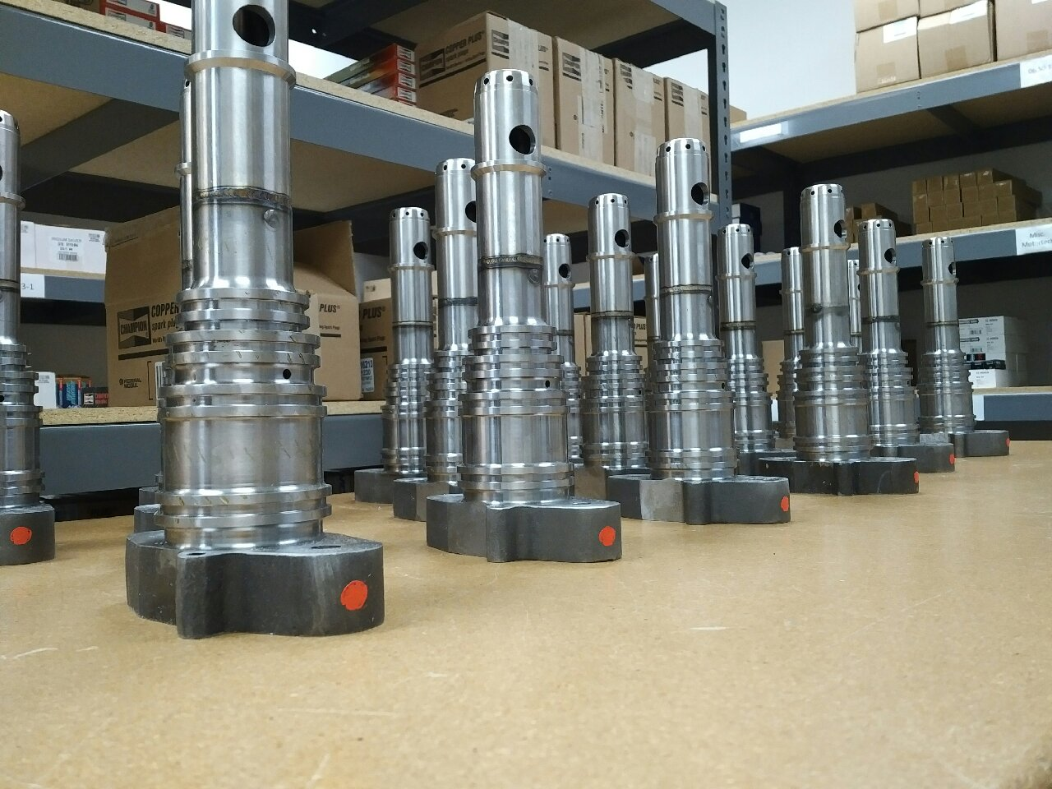
G3600 Series One Piece Prechamber

Slide 2
Engineering
Investment Casting vs. Sand Casting
Our pre-chambers are manufactured using a state-of-the-art Investment Casting Process that results in superior dimensional tolerances, ideal surface finishes and improved grain structure of the metal throughout the casting.
The Investment Casting Process consistently provides dimensional tolerances of +/- .002 inches.
The O.E.M./Caterpillar® casting uses a Sand Casting Process which is considered to be a lower quality process than the Investment Casting Process.
Fuel Delivery Ports and Channels machined to perfection
The fuel port in the body assembly of our Pre-Chamber is machined in a 5 axis CNC machine to insure exact dimensions and repeatability on every casting. This process assures consistent fuel flow delivery to the check valve and ease of setting the Air-Fuel ratio.

Slide 3
Engineering
Tip Material is Advanced and Hardness Improved vs. O.E.M.
To provide longer life, our Pre-Chamber tip is manufactured using a 625 Inconel material to prevent premature metal erosion caused by the extreme high temperatures while also being corrosion resistant.
Our tip is polished to a higher luster using the Drag Finishing Process with Ceramic Pins. This process results in a product that has a better surface finish with a surface grain structure that is “polished over,” thus creating a surface that is resilient to oxidation and more resistant to the formation carbon buildup.
Mid Flange Diameter Design
This dimension of the Mid Flange has been increased by .060” to create a better
sealing surface where the tip seals at the entry area to the combustion chamber.
Improved Tip Machining
The inside of the tips are machined for an improved surface finish and
resistance to corrosion and carbon build up.
Pressure Testing and Quality Control Checks
Hydrostatic and pressure testing on all tips to insure against leakage.
Every Pre-Chamber is subject to an extensive Quality Check for size, finish,
and consistency before they are submitted for the hydrostatic pressure.

